Slide 1
Implementation of an Othello Player
Sara Gholami,
Sara Ghaemi

Slide 2
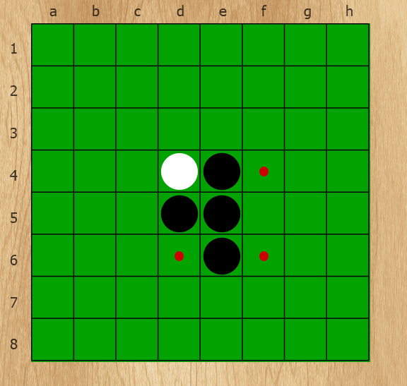
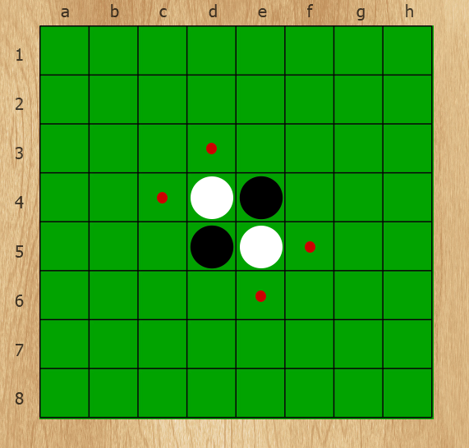
What is Othello
Also called Reversi
Two player game
Black goes first

Slide 3
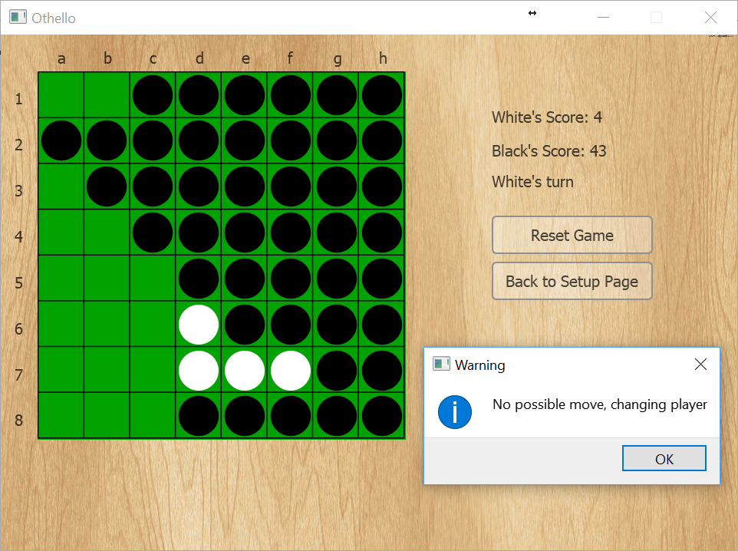
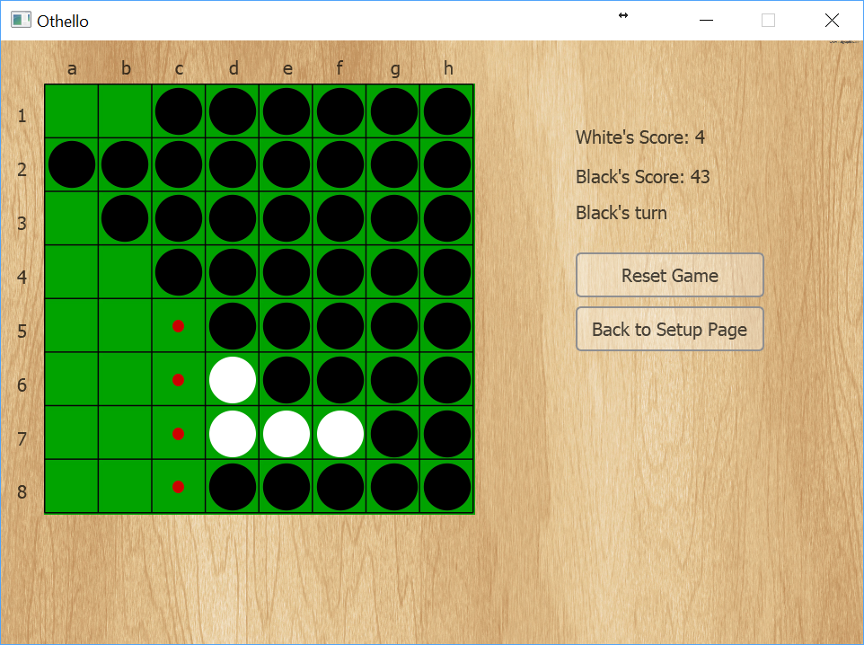
Special Case

Slide 4
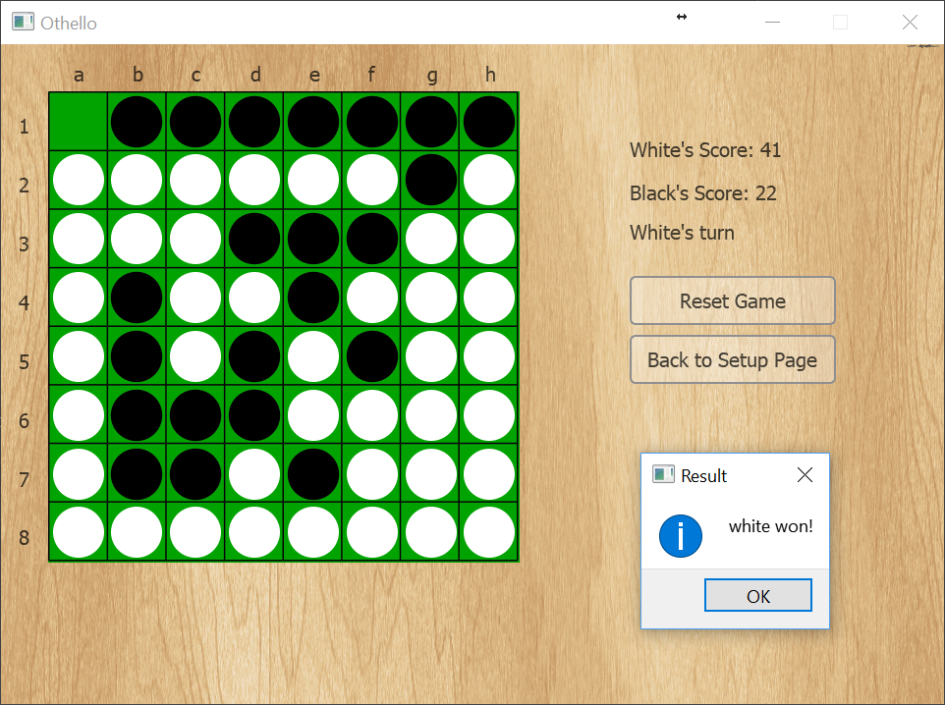
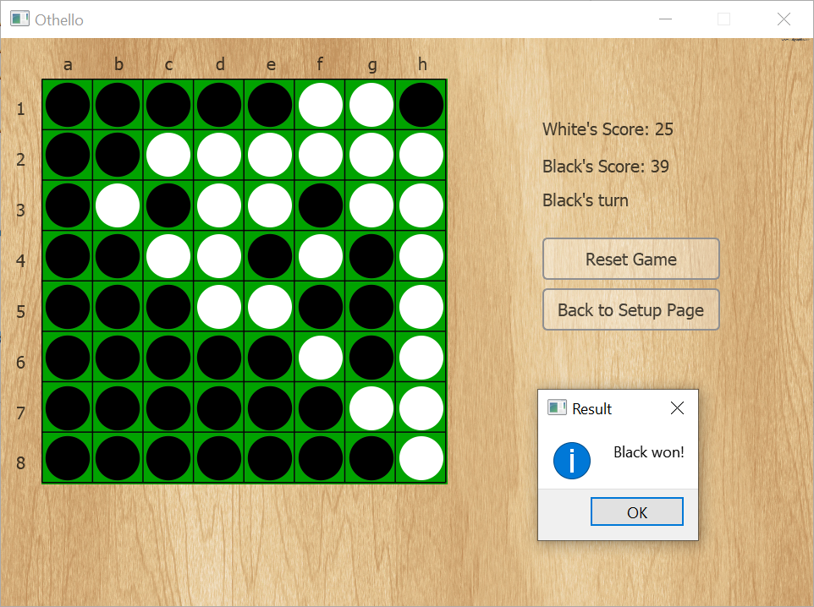
Termination Condition
No one has any move
The board is full

Slide 5
Our Computer Player - Heuristics
Coin Parity
Static Weighting
Mobility
Potential Mobility
Corners
Stability

Slide 6
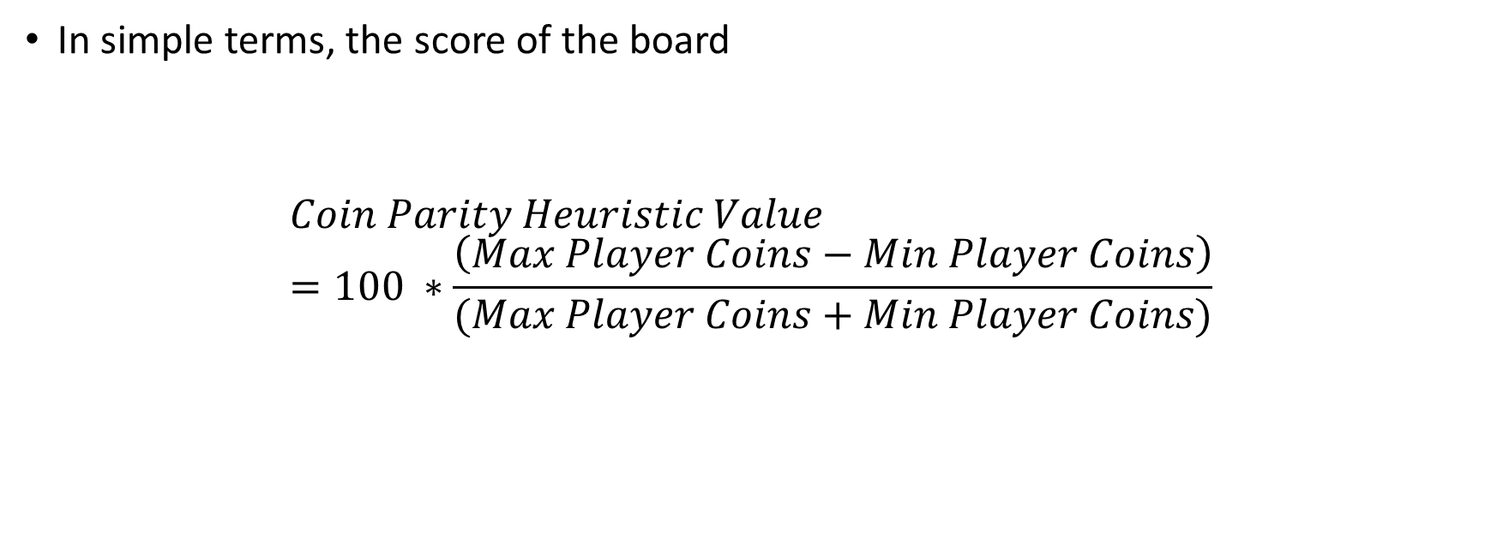
Heuristics - Coin Parity
In simple terms, the score of the board
$$Coin Parity Heuristic Value=100 ∗\frac{\left(Max Player Coins−Min Player Coins\right)}{(Max Player Coins+Min Player Coins)}$$

Slide 7
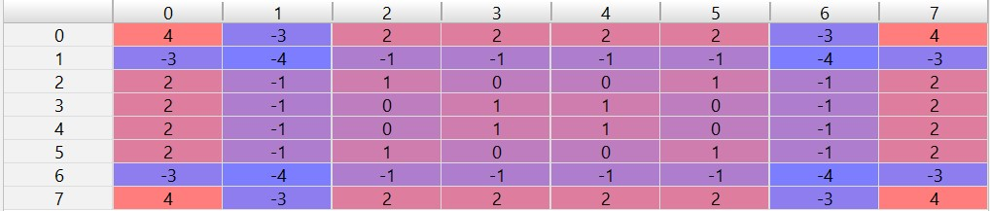
Heuristics – Static Weighting
Adding together weights of the squares in which the player’s coins are present

Slide 8
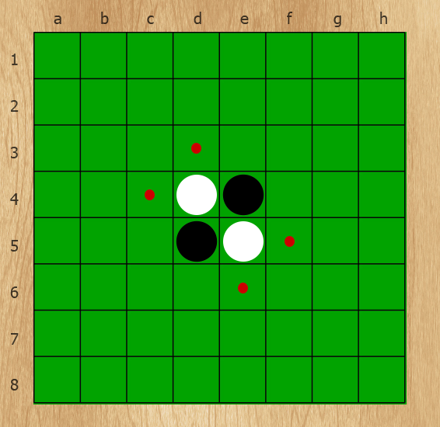
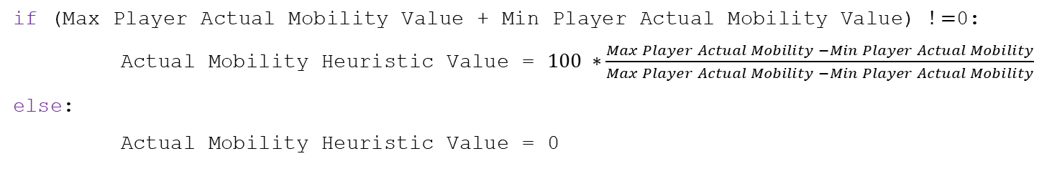
Heuristics - Mobility
if (Max Player Actual Mobility Value + Min Player Actual Mobility Value) $!=$0:
Actual Mobility Heuristic Value = $100 ∗\frac{Max Player Actual Mobility −Min Player Actual Mobility}{Max Player Actual Mobility −Min Player Actual Mobility}$
else:
Actual Mobility Heuristic Value = 0

Slide 9
Heuristics - Potential Mobility
The number of empty spaces next to at least one of the opponent’s coin

Slide 10
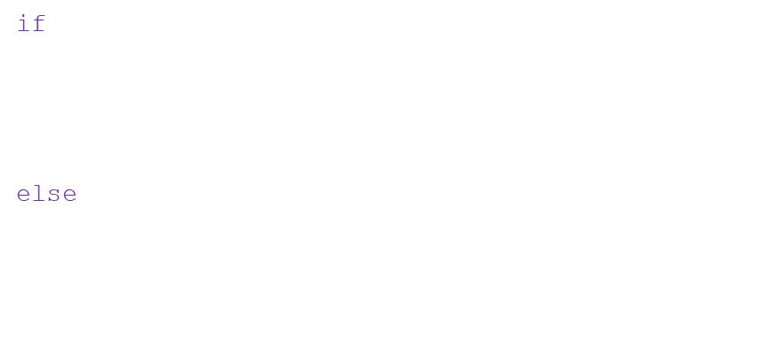
Heuristics - Corners
Once captured cannot be flanked
if (Max Player Corner Value + Min Player Corner Value) $!=$0:
Corner Heuristic Value = $100 ∗\frac{Max Player Corner Heuristic Value −Min Player Corner Heuristic Value}{Max Player Corner Heuristic Value−Min Player Corner Heuristic Value}$
else:
Corner Heuristic Value = 0

Slide 11
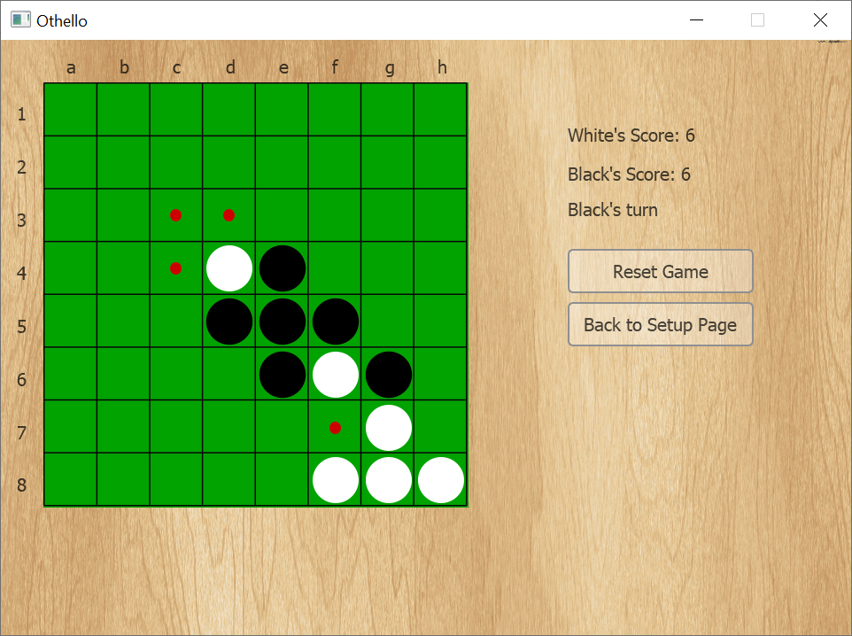
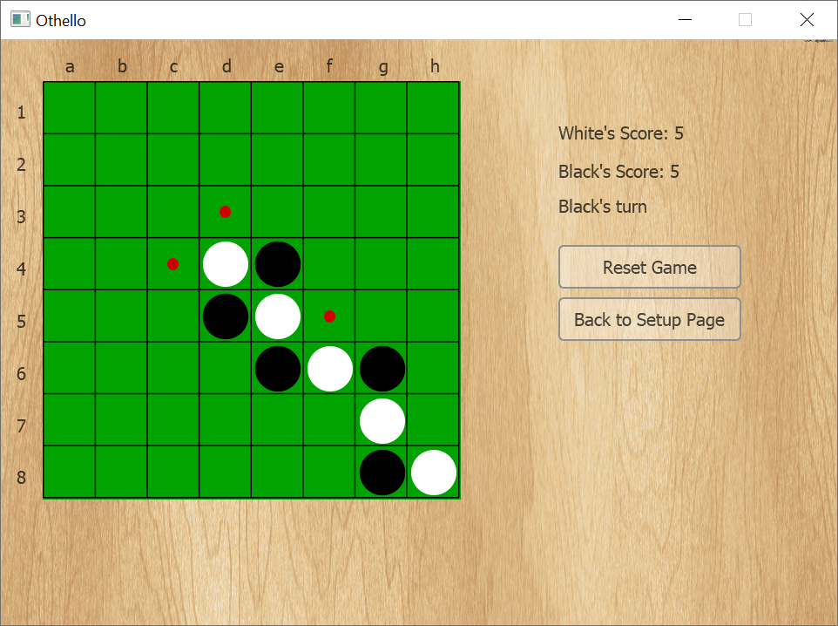
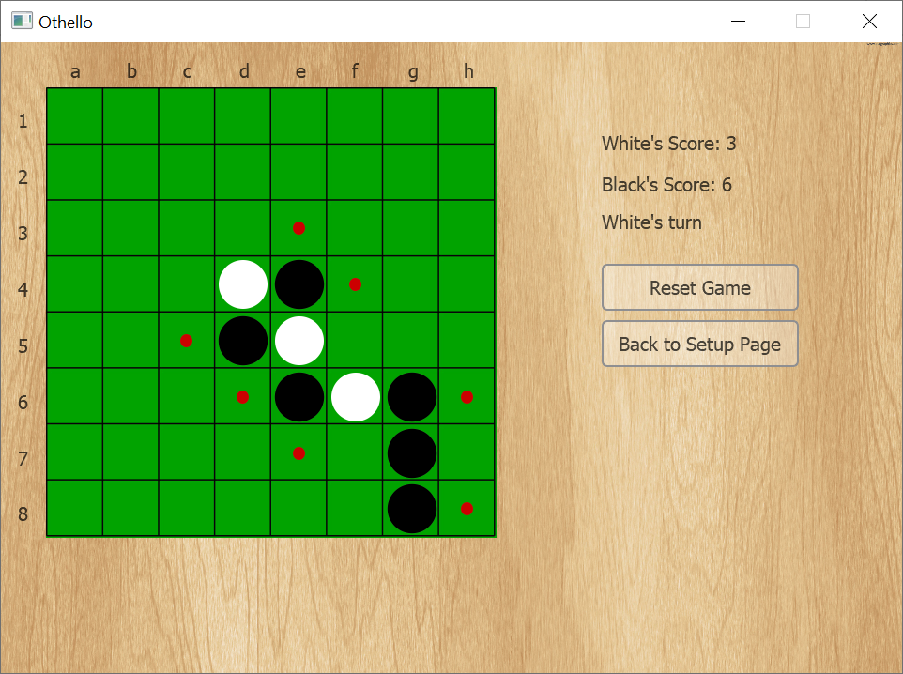
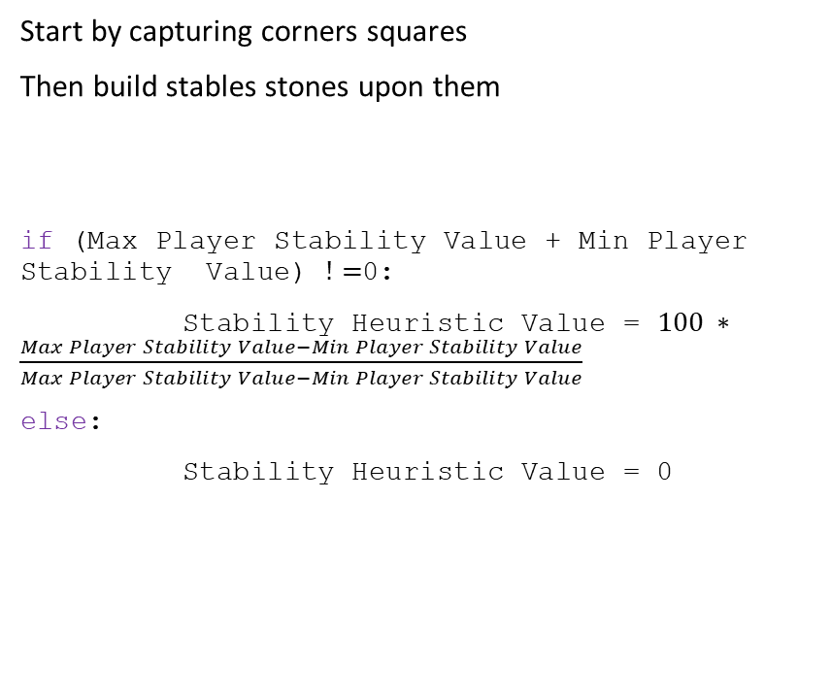
Heuristics - Stability
Start by capturing corners squares
Then build stables stones upon them
if (Max Player Stability Value + Min Player Stability Value) $!=$0:
Stability Heuristic Value = $100 ∗\frac{Max Player Stability Value−Min Player Stability Value}{Max Player Stability Value−Min Player Stability Value}$
else:
Stability Heuristic Value = 0

Slide 12

Combining Heuristics
Combine the heuristics result with a linear combination
$$60 ∗ stability+ 80 ∗ corners+ 10 ∗ mobility+ 10 ∗ potential_mobility+ 10 ∗ coin_parity + 20 ∗ static_weight$$

